Slide 1
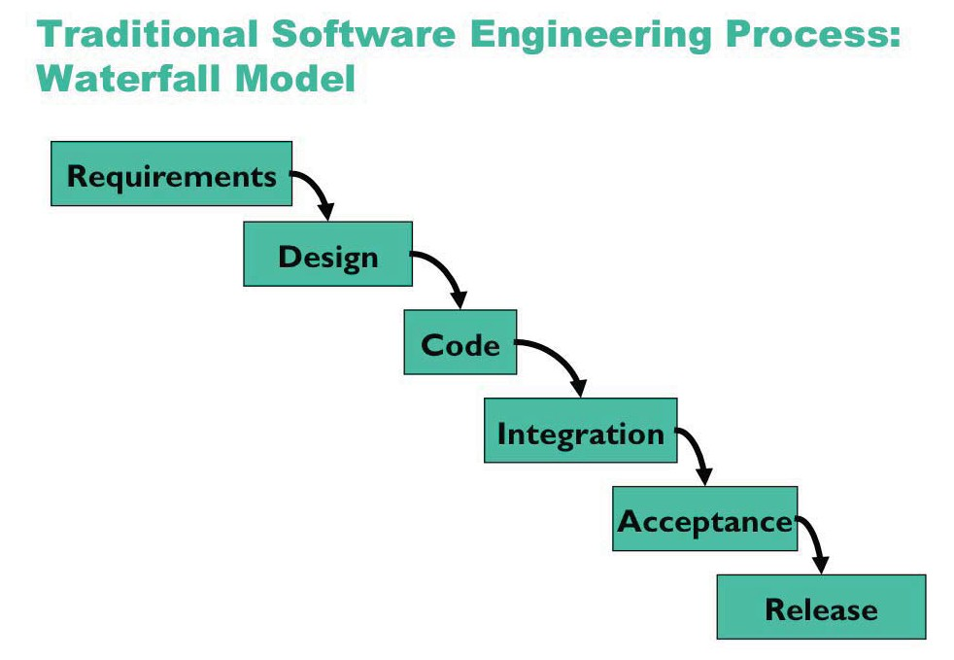

Slide 2
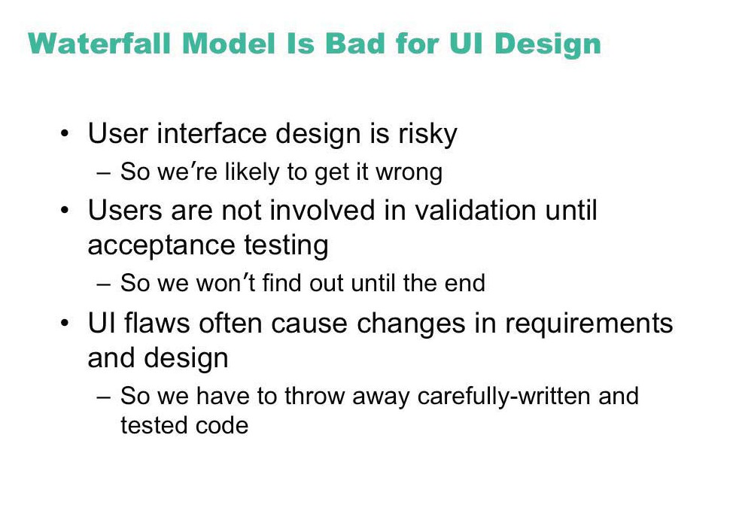

Slide 3
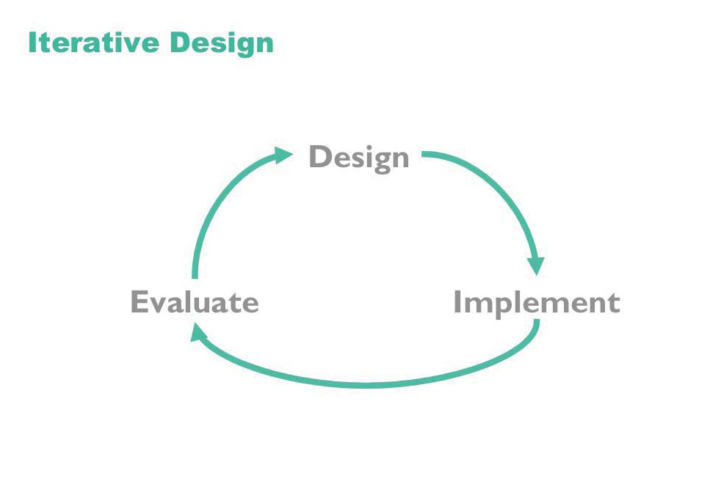

Slide 4
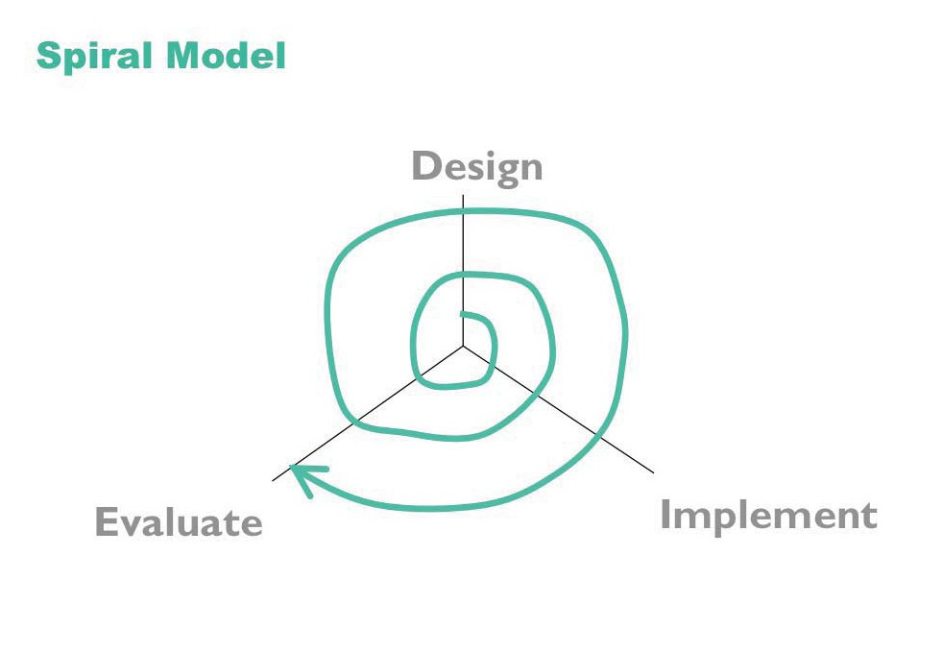

Slide 5
Methodology Outline
Task analysis
User definition
Conceptual design
Semantic design
Syntactic design
Lexical design
Documentation design
Design reviews
Prototyping
User testing
Implementation

Slide 6
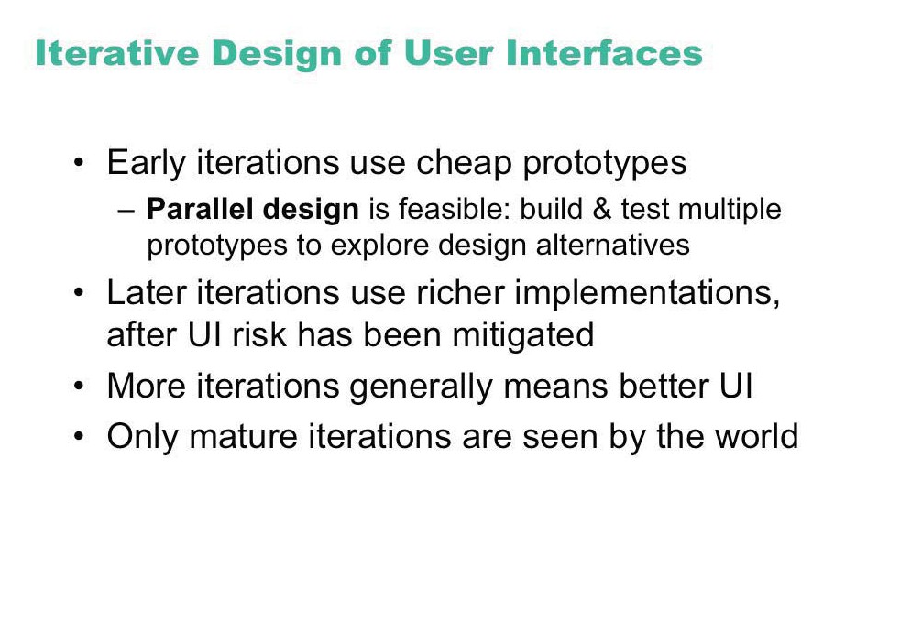

Slide 7
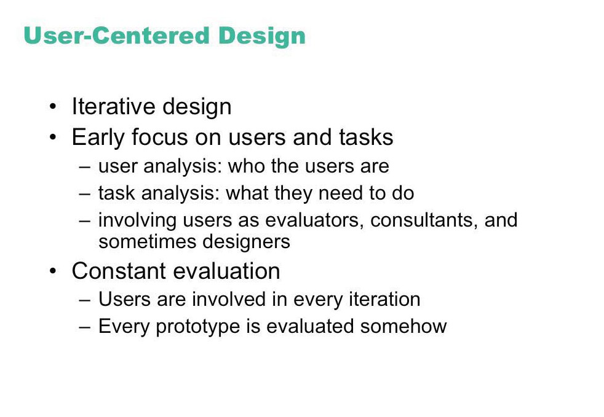

Slide 8
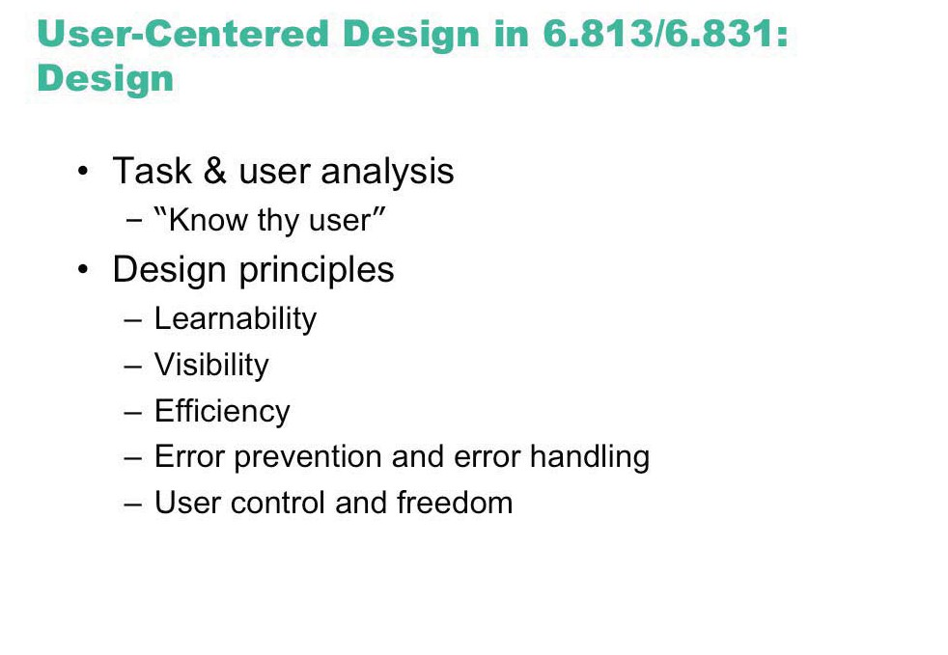
Design

Slide 9
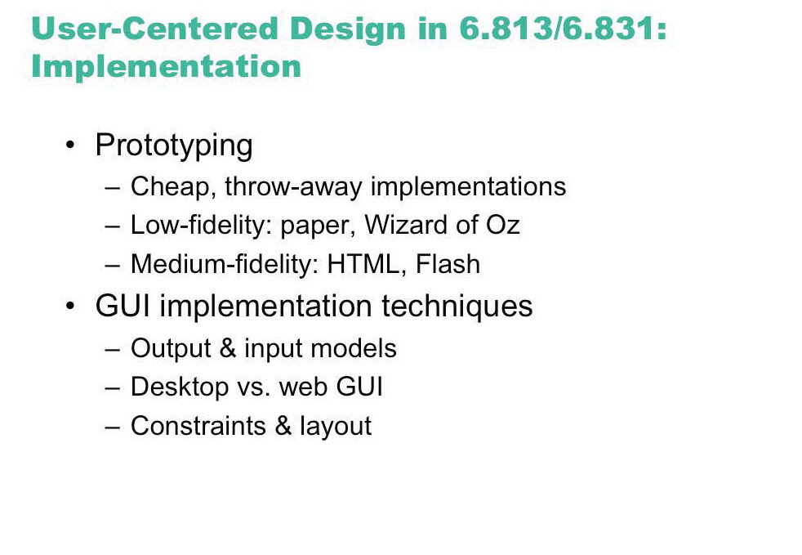
Implementation

Slide 10
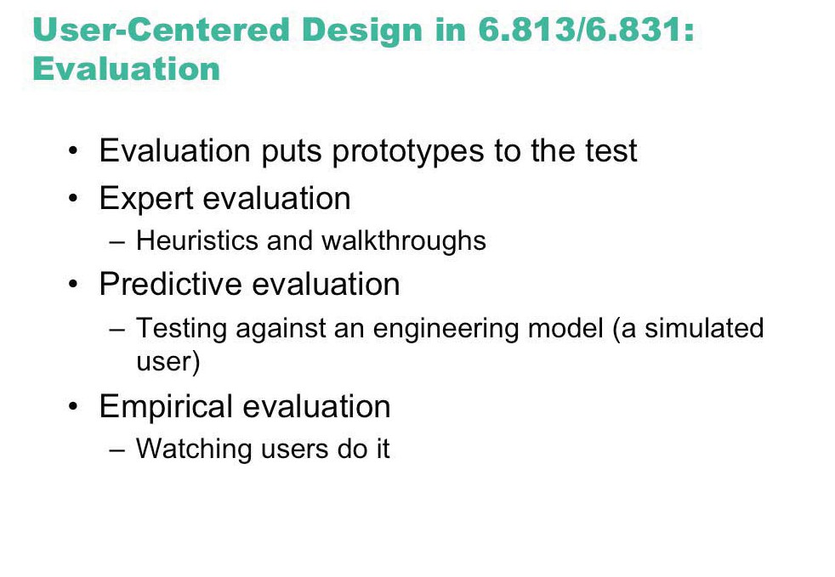
Evaluation

Slide 11
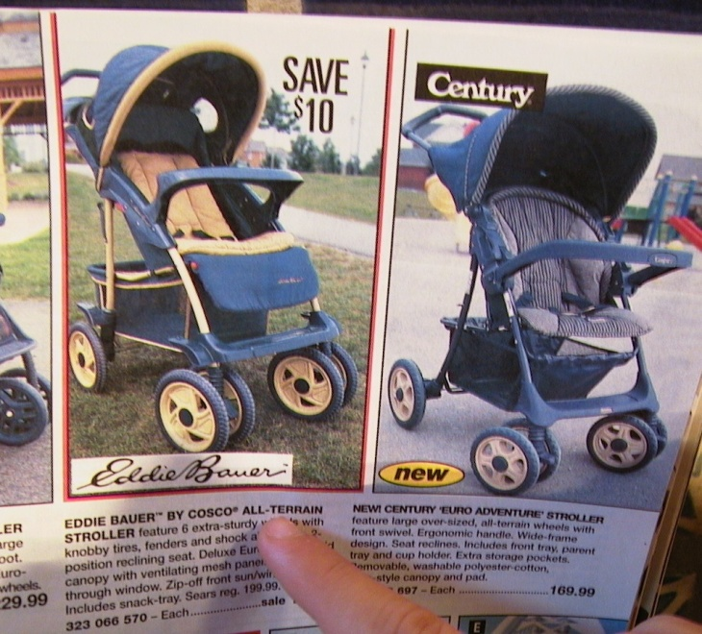
Example: The Cheap Shop Catalog Store
In Cheap Shop, people shop by browsing paper catalogs scattered around the store.
When people see an item they want, they enter its item code from the catalog onto a form.
People give this form to a clerk, who brings the item(s) from the back room to the front counter.
People then pay for the items they want.
Item code Amount

Slide 12
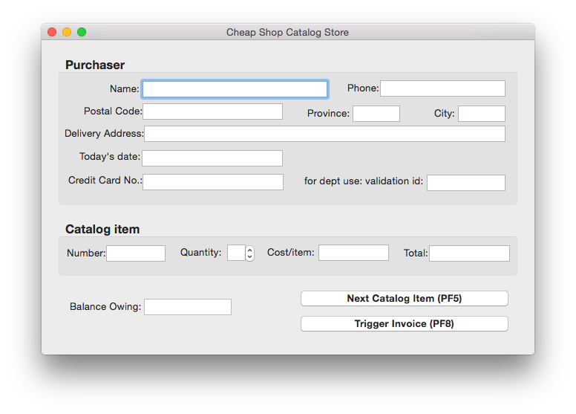
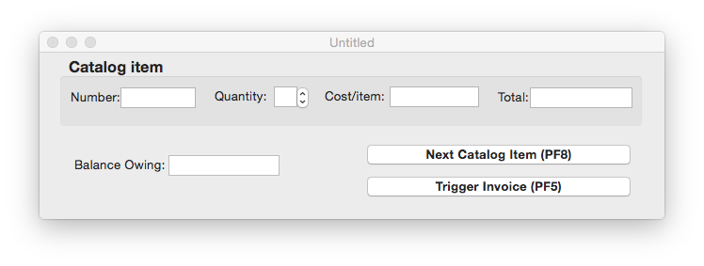
Cheap Shop
Screen 1
Screen 2

Slide 13
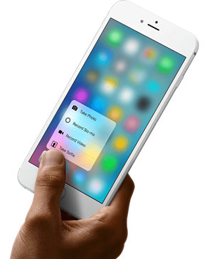
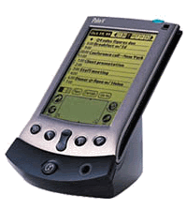
Phase 1: Identify users + tasks
If there are no real users or tasks…
think again, there probably are!
Jeff Hawkins, the inventor of the Palm Pilot, was said to have carried a small block of wood around in his shirt pocket … As various everyday situations arose, he would take out the block of wood and imagine how he would use the device.¹
The same technique can be used to evoke a response from expected end-users
¹see Sato and Salvador, interactions 6(5)

Slide 14
The Cheap Shop Catalog Store
In Cheap Shop, people shop by browsing paper catalogs scattered around the store.
When people see an item they want, they enter its item code from the catalog onto a form.
People give this form to a clerk, who brings the item(s) from the back room to the front counter.
People then pay for the items they want.

Slide 15
Developing task examples
Task example 1
Fred Johnson, who is caring for his demanding toddler son, wants a good quality umbrella stroller (red is preferred, but blue is acceptable).
He browses the catalog and chooses the JPG stroller (cost $98. item code 323 066 697).
He pays for it in cash, and uses it immediately.
Fred is a first-time customer to this store, has little computer experience, and says he types very slowly with one finger. He lives nearby on Dear Bottom Avenue NW.
JPG Stroller. This well made but affordable Canadian stroller fits children between 1-3 years old. Its wheels roll well in light snow and mud.
…$98.
Red: 323 066 697
Blue: 323 066 698

Slide 16
Developing task examples
Task example 2
Mary Vornushia is price-comparing the costs of a child’s bedroom set, consisting of a wooden desk, a chair, a single bed, a mattress, a bedspread, and a pillow all made by Furnons Inc.
She takes the description and total cost away with her to check against other stores.
Three hours later, she returns and decides to buy everything but the chair.
She pays by credit card,
She asks for the items to be delivered to her daughter’s home at 31247 Lucinda Drive, in the basement suite at the back of the house.
Mary is elderly and arthritic.

Slide 17
Developing task examples
Task example 3
John Forham, the sole salesperson in the store, is given a list of 10 items by a customer who does not want to use the computer.
The items are:
4 pine chairs, 1 pine table, 6 blue place mats, 6 “lor” forks, 6 “lor” table spoons, 6 “lor” teaspoons, 6 “lor” knives, 1 “tot” tricycle, 1 red ball, 1 “silva” croquet set
After seeing the total, the customer tells John he will take all but the silverware
The customer then decides to add 1 blue ball to the list.
The customer starts paying by credit card, but then decides to pay cash. The customer tells John he wants the items delivered to his home the day after tomorrow. While this is occurring, 6 other customers are waiting for John.
John has been on staff for 1 week, and is only partway through his training program

Slide 18
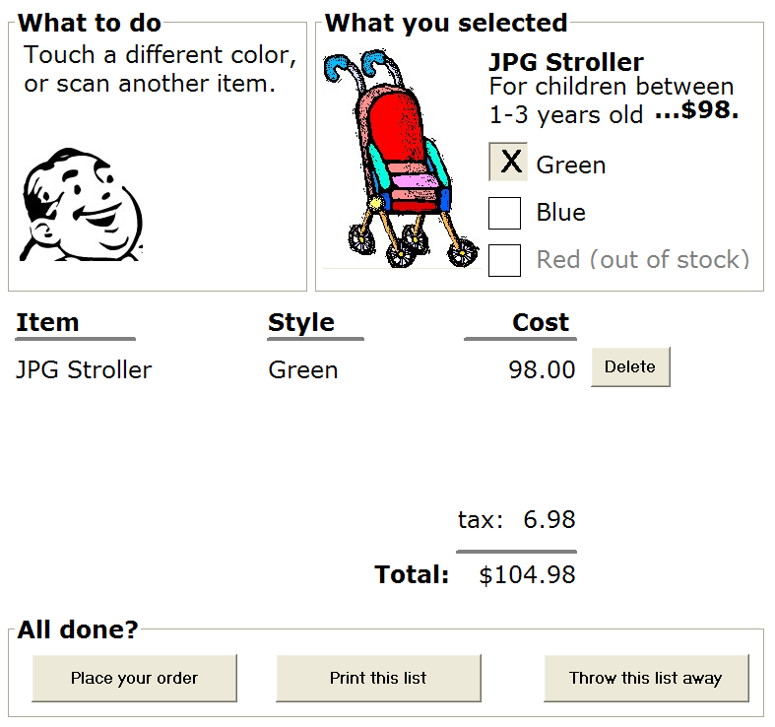
Are there better ways to do it?
A task-centered prototype
partial wizard approach to tasks
prototyped several different ways
paper - 45 minutes
scripted animation - 2 hours

Slide 19
Cheap Shop
Screen 1
Screen 2

Slide 20
Walkthrough template
Task number: ____
Description of Step
Does the user have the knowledge/training to do this?
Is it believable that they would do it? Are they motivated?
Comment / solution
A walkthrough for this exercise is found in Greenberg, S. “Working through Task-Centered System Design. in Diaper, D. and Stanton, N. (Eds) The Handbook of Task Analysis for Human-Computer Interaction. Lawrence Erlbaum Associates.

Slide 21
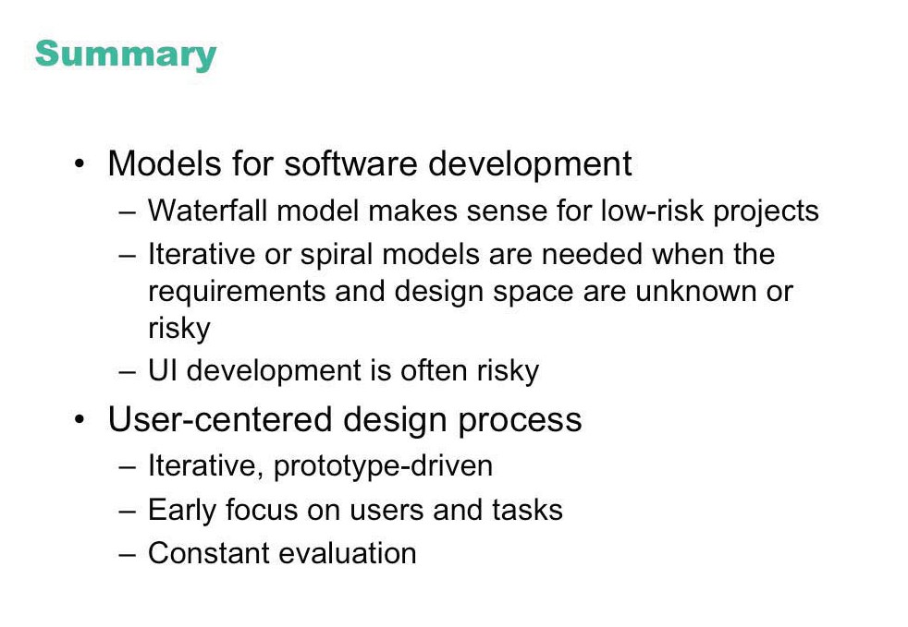

Slide 22
Methodology Outline
Task analysis
User definition
Conceptual design
Semantic design
Syntactic design
Lexical design
Documentation design
Design reviews
Prototyping
User testing
Implementation

Slide 23
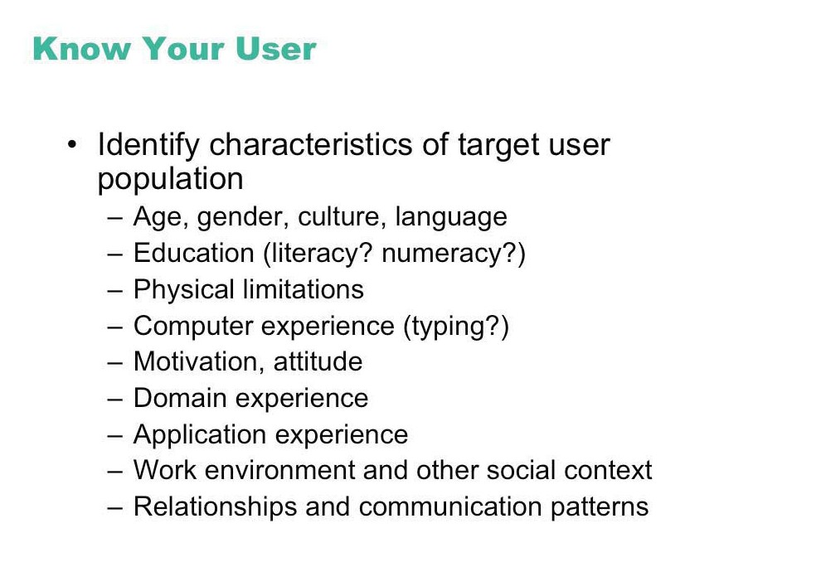

Slide 24
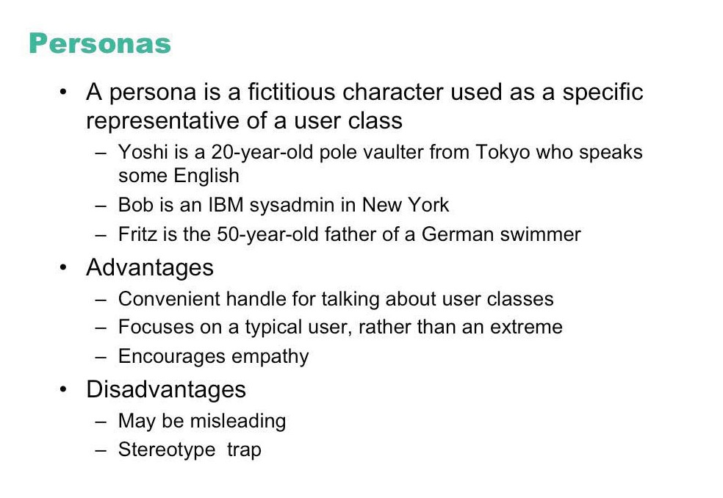

Slide 25
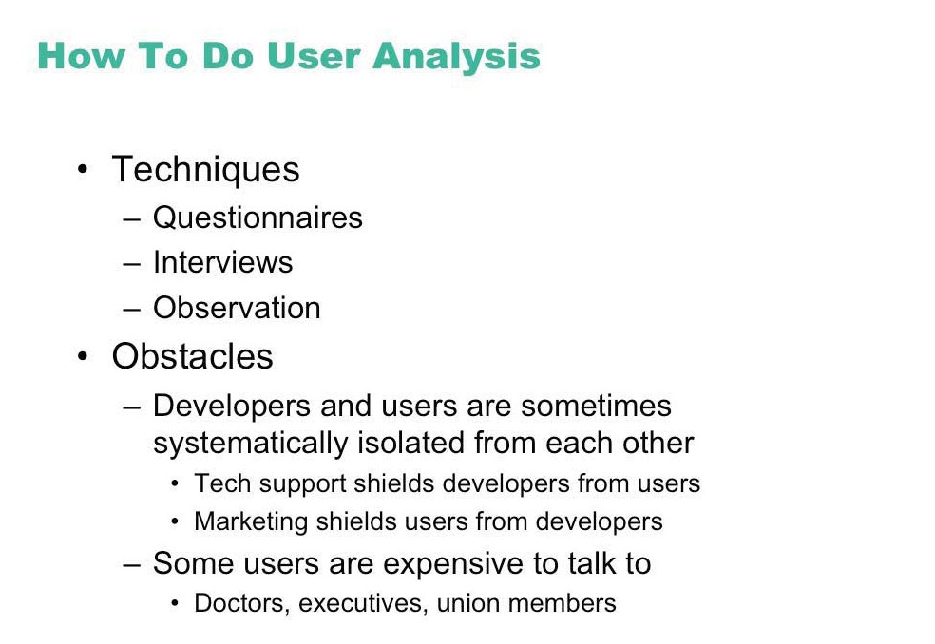

Slide 26
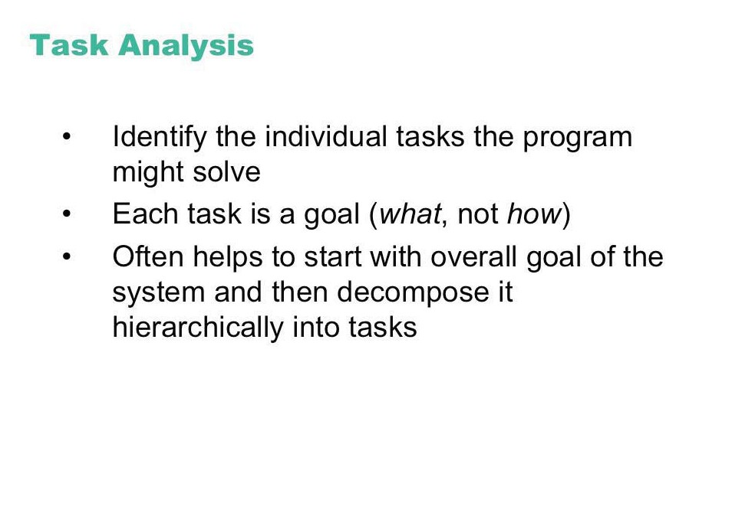

Slide 27
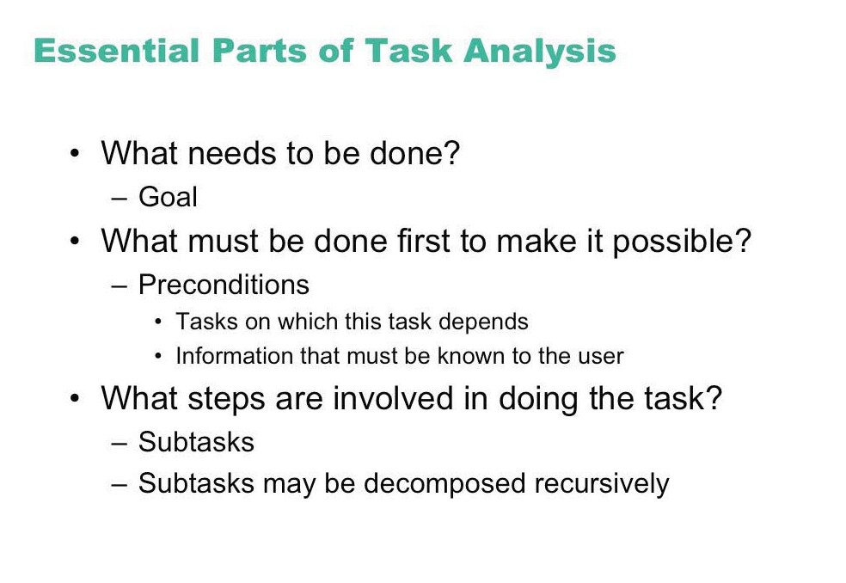

Slide 28
An Example
in order to clean the house
get the vacuum cleaner out
fix the appropriate attachments
clean the rooms
when the dust bag gets full, empty it
put the vacuum cleaner and tools away
must know about:
vacuum cleaners, their attachments, dust bags, cupboards, rooms etc.

Slide 29
Approaches to task analysis
Task decomposition
splitting task into (ordered) subtasks
Knowledge based techniques
what the user knows about the task and how it is organised
Entity/object based analysis
relationships between objects, actions and the people who perform them
lots of different notations/techniques

Slide 30
general method
observe
collect unstructured lists of words and actions
organize using notation or diagrams

Slide 31
Differences from other techniques
Systems analysis vs. Task analysis
system design - focus - the user
Cognitive models vs. Task analysis
internal mental state - focus - external actions
practiced `unit' task - focus - whole job

Slide 32
Task Decomposition
Aims: describe the actions people do structure them within task subtask hierarchy describe order of subtasks
Variants: Hierarchical Task Analysis (HTA) most common CTT (CNUCE, Pisa) uses LOTOS temporal operators

Slide 33
Textual HTA description
Hierarchy description ...
0. in order to clean the house
1. get the vacuum cleaner out
2. get the appropriate attachment
3. clean the rooms
3.1. clean the hall
3.2. clean the living rooms
3.3. clean the bedrooms
4. empty the dust bag
5. put vacuum cleaner and attachments away
... and plans
Plan 0: do 1 - 2 - 3 - 5 in that order. when the dust bag gets full do 4
Plan 3: do any of 3.1, 3.2 or 3.3 in any order depending on which rooms need cleaning
N.B. only the plans denote order

Slide 34
Generating the hierarchy
1 get list of tasks
2 group tasks into higher level tasks
3 decompose lowest level tasks further
Stopping rules How do we know when to stop? Is “empty the dust bag” simple enough? Purpose: expand only relevant tasks Motor actions: lowest sensible level

Slide 35
Tasks as explanation
imagine asking the user the question: what are you doing now?
for the same action the answer may be: typing ctrl-B making a word bold emphasising a word editing a document writing a letter preparing a legal case

Slide 36
parse scenario using HTA
get out cleaner
fix carpet head
clean dinning room
clean main bedroom
empty dustbag
clean sitting room
put cleaner away
1.
2.
3.2.
3.
0.
3.3.
4.
3.2.
5.
0. in order to clean the house
1. get the vacuum cleaner out
2. get the appropriate attachment
3. clean the rooms
3.1. clean the hall
3.2. clean the living rooms
3.3. clean the bedrooms
4. empty the dust bag
5. put vacuum cleaner and attachments away

Slide 37
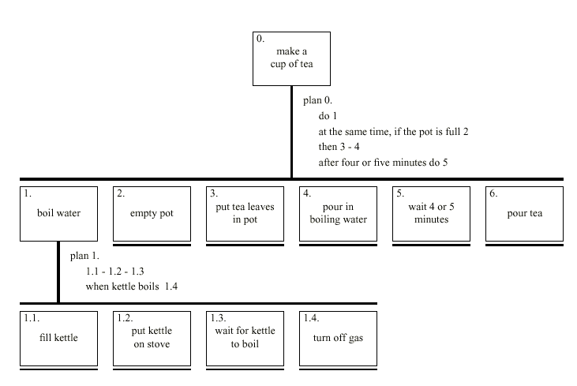
Diagrammatic HTA

Slide 38
Refining the description
Given initial HTA (textual or diagram)
How to check / improve it?
Some heuristics:
paired actions e.g., where is `turn on gas'
restructure e.g., generate task `make pot'
balance e.g., is `pour tea' simpler than making pot?
generalise e.g., make one cup ….. or more

Slide 39
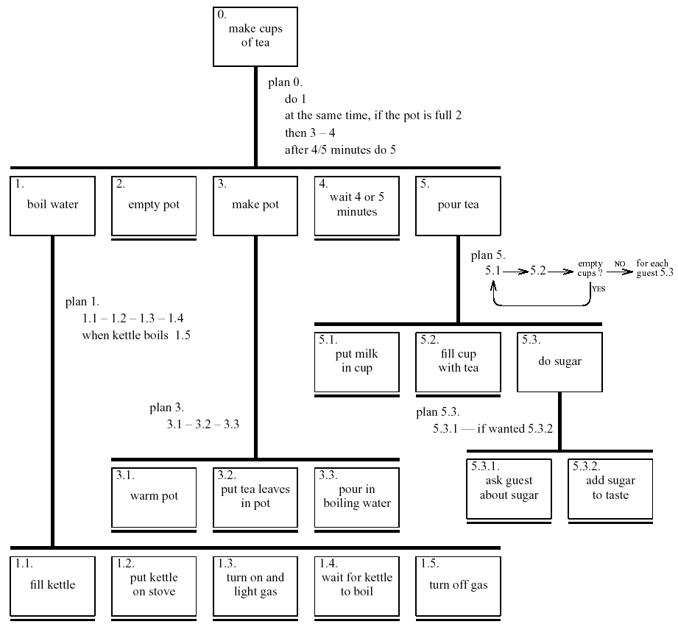
Refined HTA for making tea

Slide 40
Types of plan
fixed sequence - 1.1 then 1.2 then 1.3
optional tasks - if the pot is full 2
wait for events - when kettle boils 1.4
cycles - do 5.1 5.2 while there are still empty cups
time-sharing - do 1; at the same time ...
discretionary - do any of 3.1, 3.2 or 3.3 in any order
mixtures - most plans involve several of the above

Slide 41

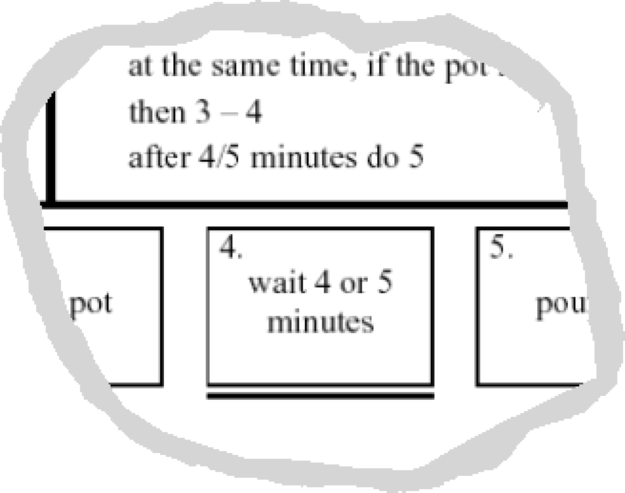
waiting …
is waiting part of a plan? … or a task?
generally
task – if ‘busy’ wait
you are actively waiting
plan – if end of delay is the event
e.g. “when alarm rings”, “when reply arrives”
in this example …
perhaps a little redundant …
TA not an exact science
see chapter 19 for more on delays!

Slide 42
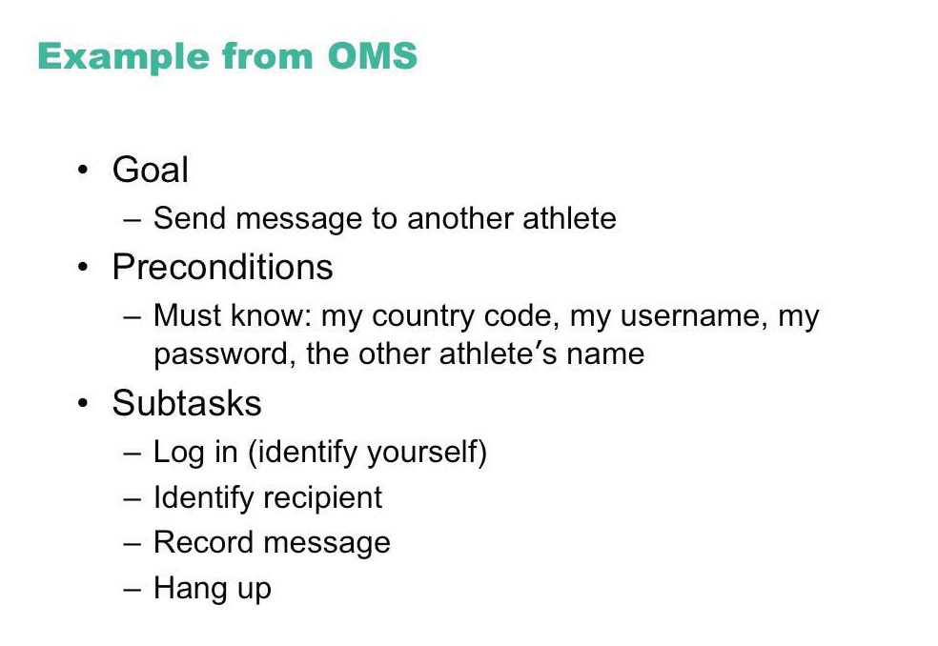

Slide 43
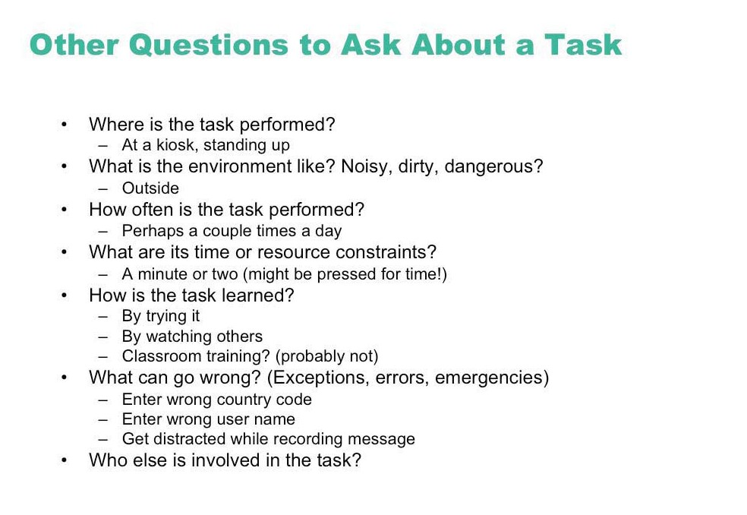

Slide 44
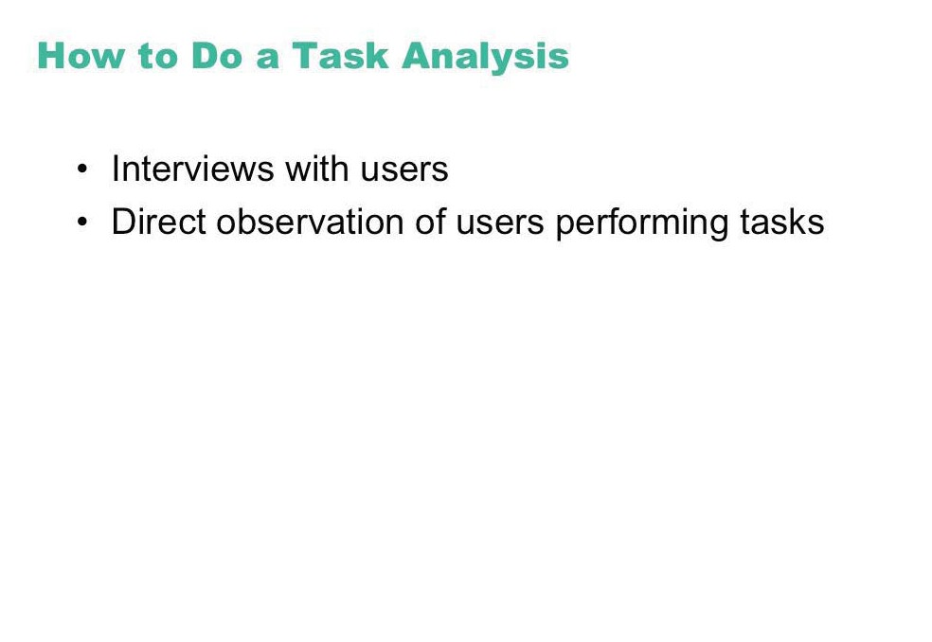

Slide 45
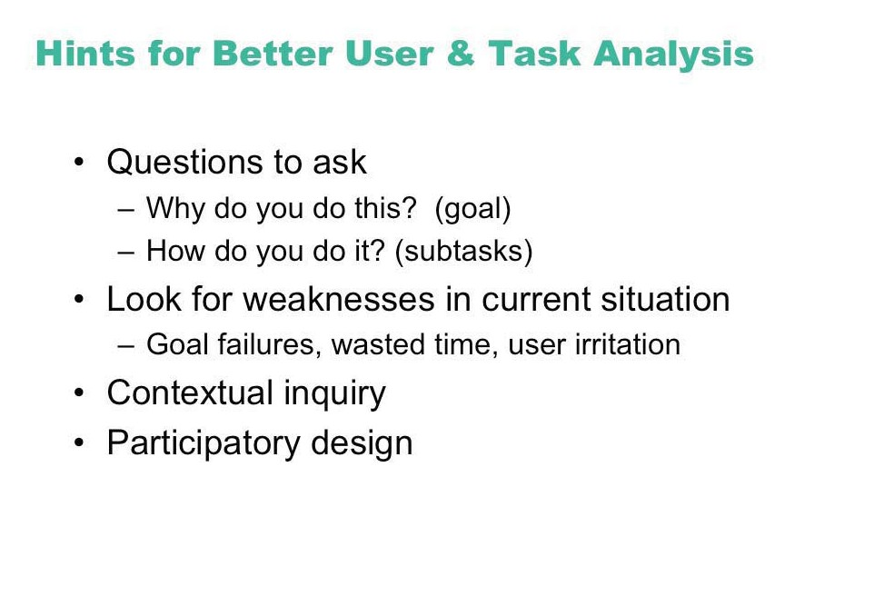

Slide 46
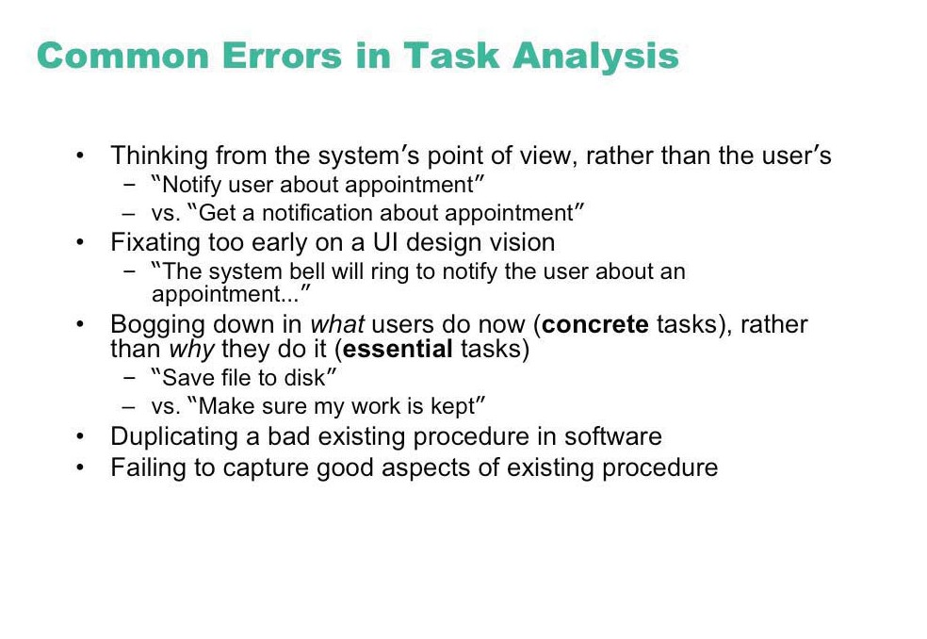

Slide 47
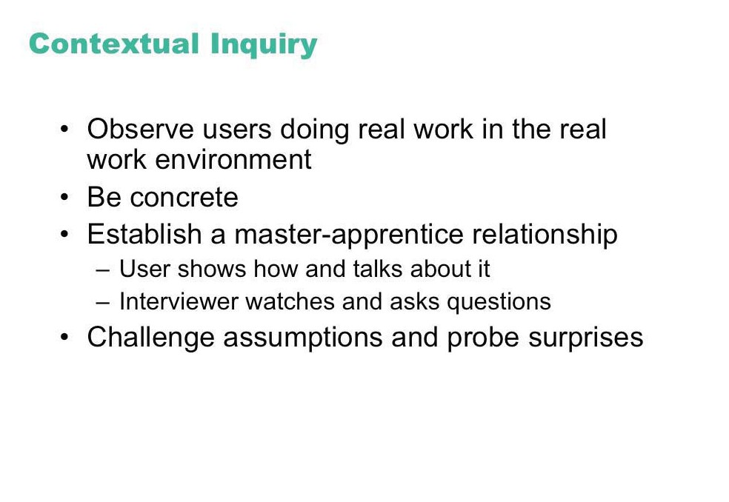

Slide 48
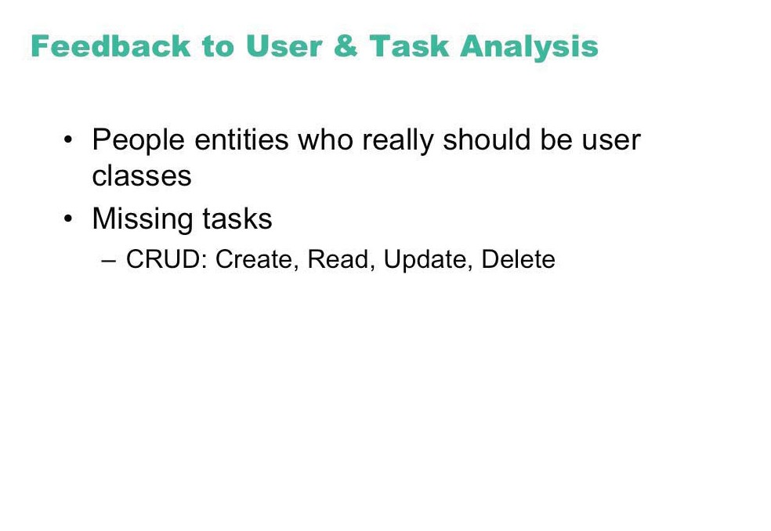

Slide 49
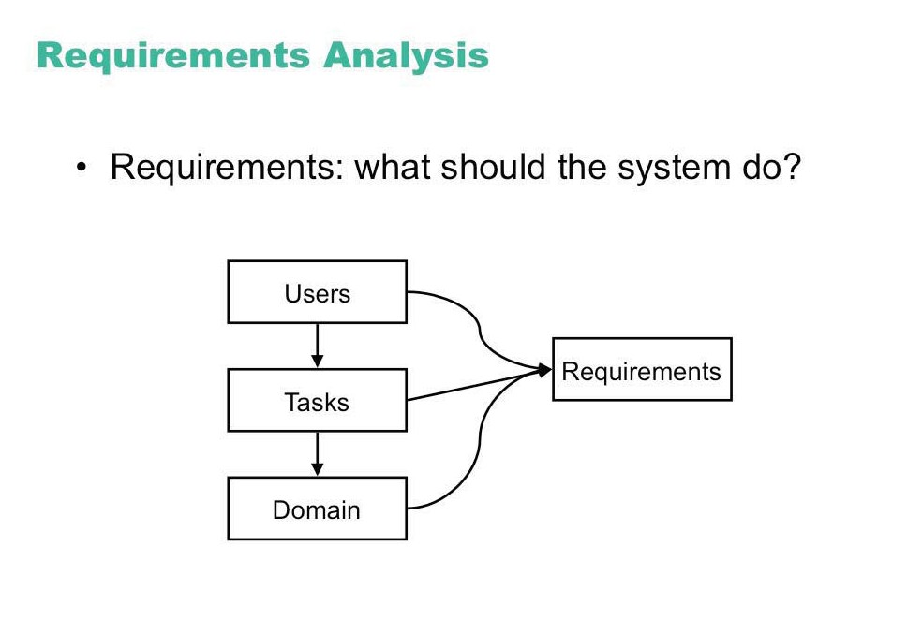

Slide 50
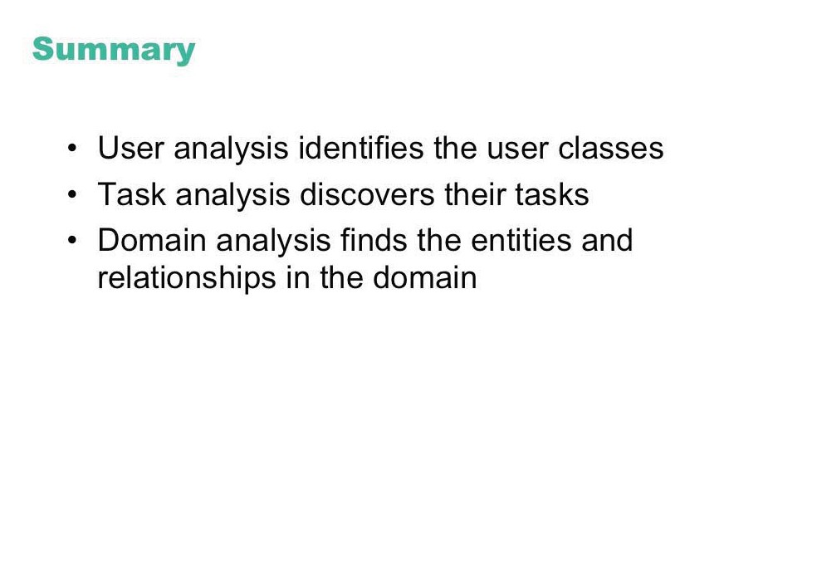

Slide 51
Design Process for Interactive Systems
Partition into Four Levels
Conceptual
Semantic
Syntactic
Lexical

Slide 52
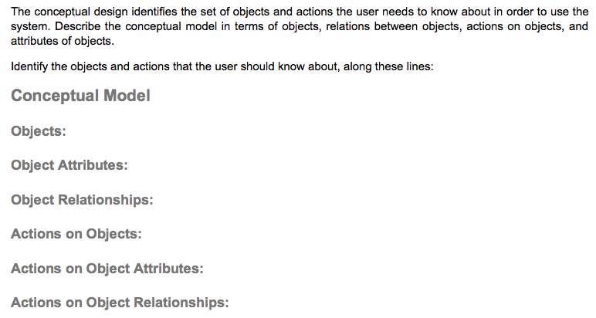
Conceptual Level
http://www.cs.tufts.edu/~jacob/171/templates.html#conceptual

Slide 53
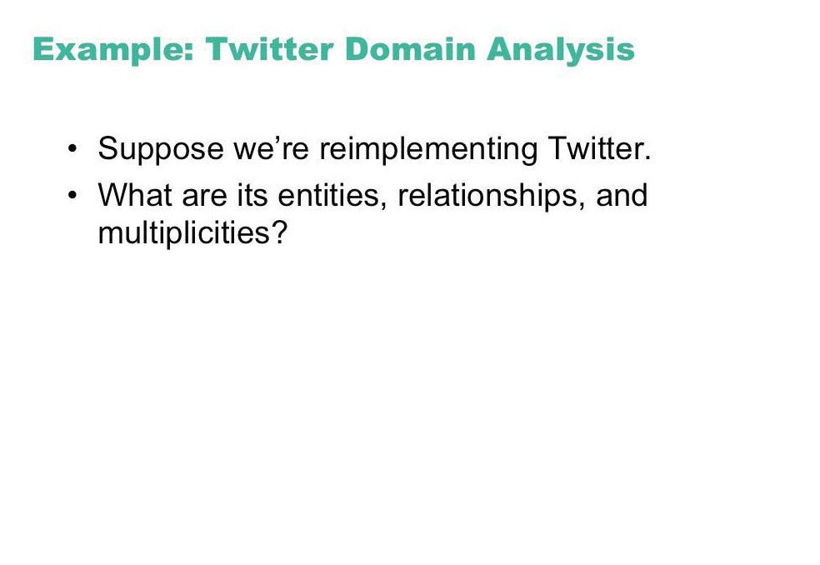

Slide 54
Design Process for Interactive Systems
Partition into Four Levels
Conceptual
Semantic
Syntactic
Lexical

Slide 55
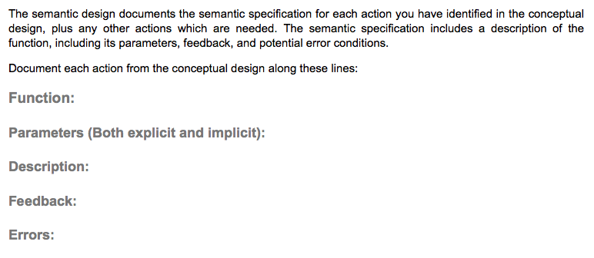
Semantic Level
http://www.cs.tufts.edu/~jacob/171/templates.html#semantic

Slide 56
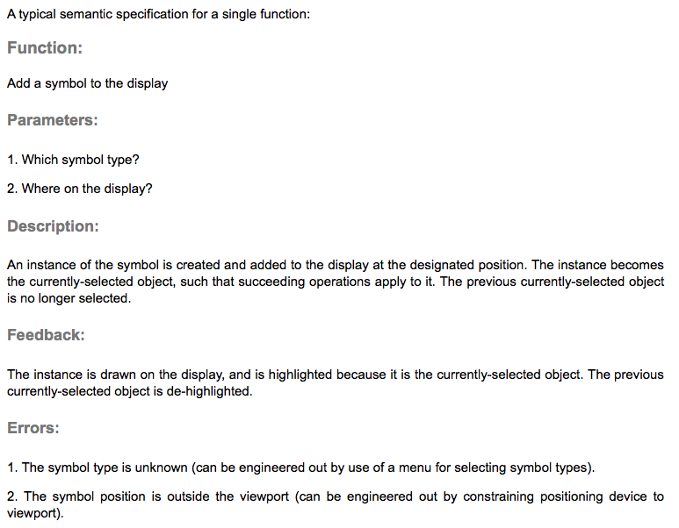
Semantic Level Specification
http://www.cs.tufts.edu/~jacob/171/templates.html#semantic

Slide 57
Design Process for Interactive Systems
Partition into Four Levels
Conceptual
Semantic
Syntactic
Lexical

Slide 58
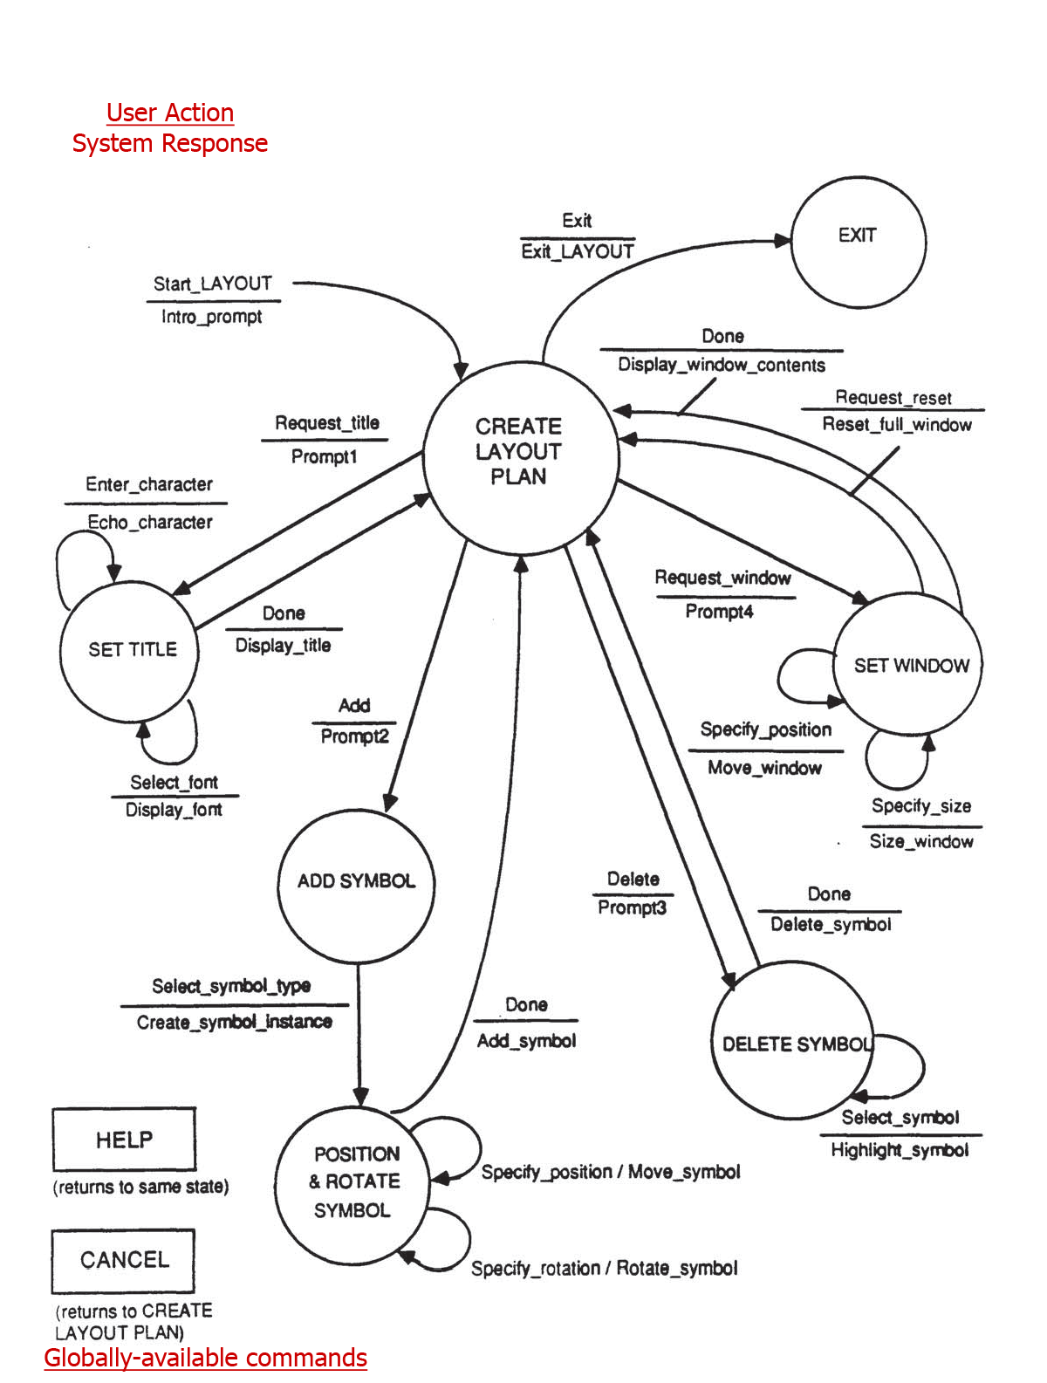
State Transition Diagram Example
http://www.cs.tufts.edu/~jacob/171/templates.html#syntactic

Slide 59
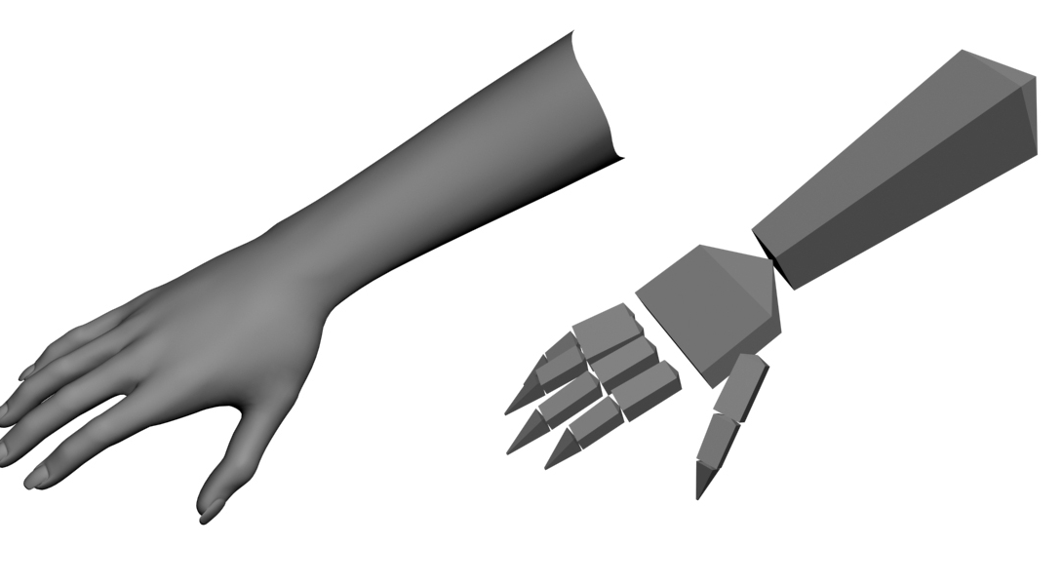
Commands for 3D Object Picking

Slide 60
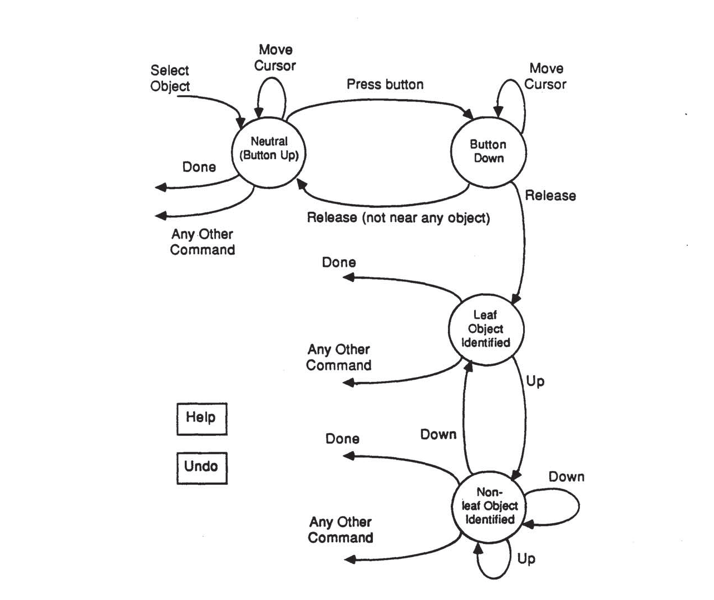
State Transition Diagram Example (2)

Slide 61
Design Process for Interactive Systems
Partition into Four Levels
Conceptual
Semantic
Syntactic
Lexical

Slide 62
Command Names (1)
Menu Choices for Electronic Calendar System
1. Schedule a meeting
2. Cancel a meeting
3. Edit a meeting
4. See calendar
5. Other options
6. Leave calendar

Slide 63
Command Names (2)
Designing Command Names for an Email System
Functions
Begin writing text
Put more text at end of current text
Make hard copy
Preserve text in a file
Get rid of some words
Get rid of whole document
Ship text as mail to addressee
Terminate session and leave system
Commands
Abbreviations
Synonyms

